Slide 1
Assignment #2
Stop-and-Wait Flow Control Implementation

Slide 2
Assignment #2
#1
#2
Implement Stop-and-Wait
Sender sends Data
Receiver responds with ACK
ACK : GO
ACK : STOP
If ACK : GO,
Sender sends the next data
If ACK : STOP,
Sender waits the ACK : GO from receiver
Assume no error
Data
ACK : GO
Data
ACK : GO
Data
ACK : STOP
ACK : GO
Data
ACK : GO

Slide 3
Assignment #2
Assignment #2 is implemented on Ethernet (EthType 0xFFFE)
Assignment #2 uses following frame structure
Dst MAC
(Broadcast)
Src MAC
EtherType (0xFFFE)
Assignment#2 Type (Data or ACK)
Payload
Ethernet Header

Slide 4
Assignment #2
Assignment #2 Data
Assignment #2 ACK
Dst MAC
(Broadcast)
Src MAC
EtherType (0xFFFE)
Assignment#2 Type (Data)
Data Length
Data (Hello, 0..15)
Dst MAC
(Broadcast)
Src MAC
EtherType (0xFFFE)
Assignment#2 Type (ACK)
ACK TYPE (GO or STOP)

Slide 5
Assignment #2
Fill the blank in the skeleton code
sw_node.c
send_data()
send_ack()
process_my_sw_proto()

Slide 6
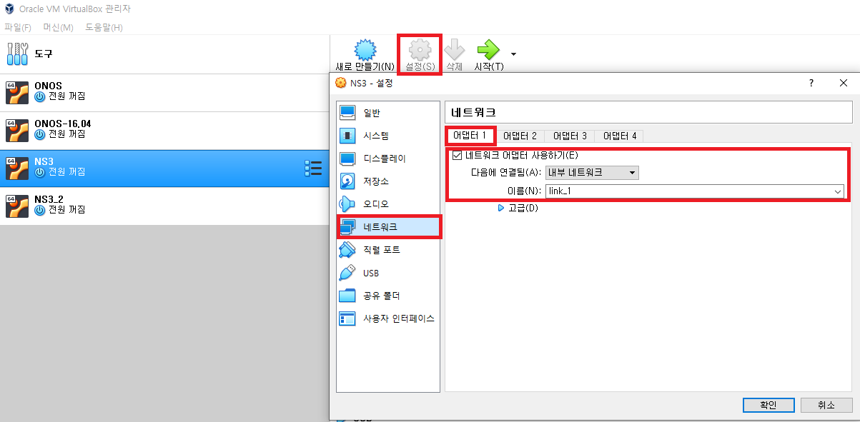
Environment Setup
Use 2 virtual machines
Network -> Internal Network

Slide 7
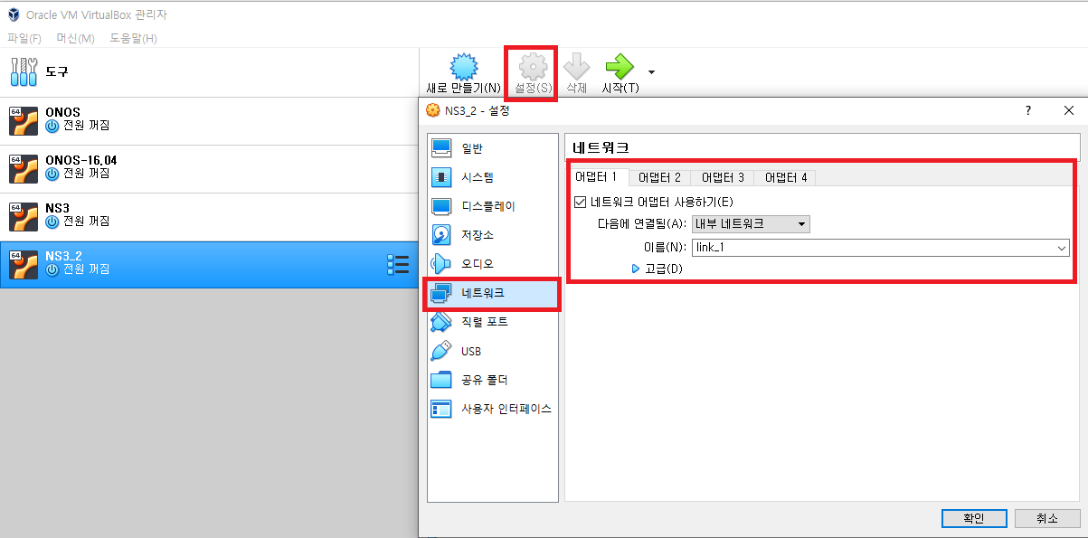
Environment Setup
Use 2 virtual machines
Network -> Internal Network

Slide 8
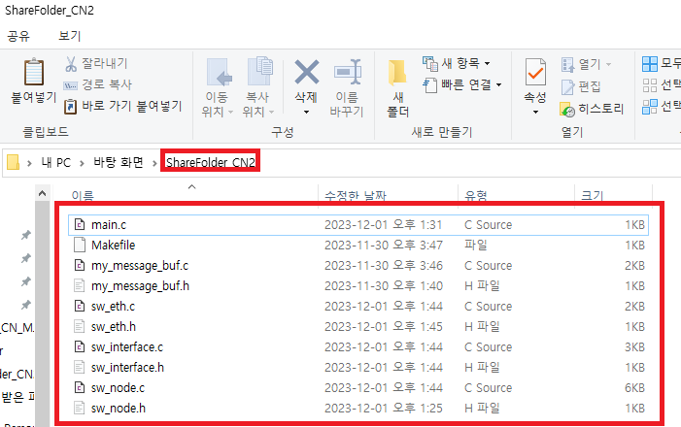
Environment Setup
Unzip the downloaded .zip file into the sharing folder

Slide 9
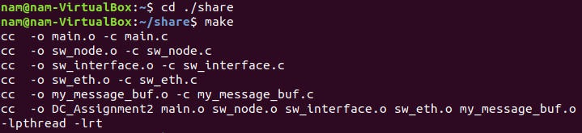
Program Compile
In VM, open terminal and input the following command to use sharing folder
Input “cd ./share” and “make”

Slide 10
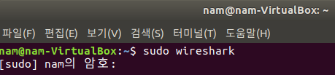
Wireshark
Run wireshark in a VM

Slide 11
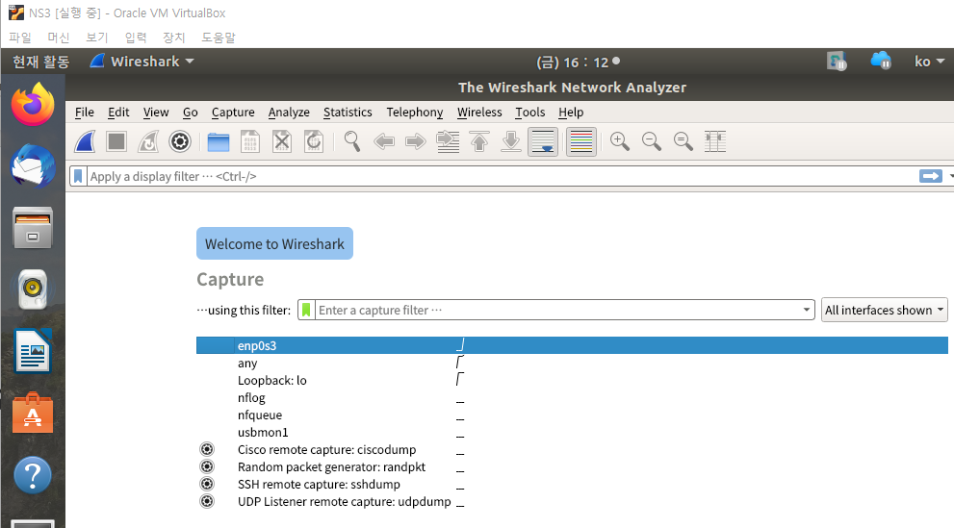
Wireshark
Start to capture frames with “enp0s3” interface

Slide 12
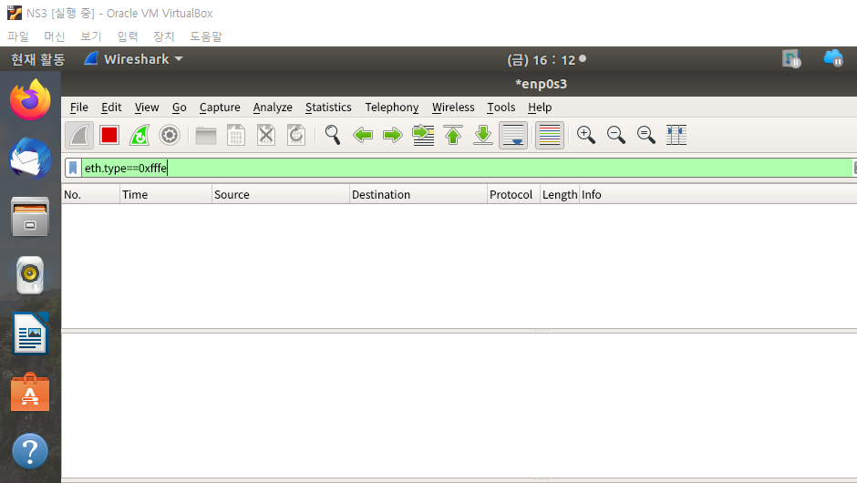
Wireshark
Filter : “eth.type==0xfffe”

Slide 13
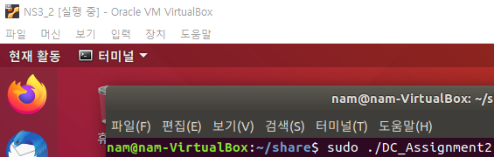
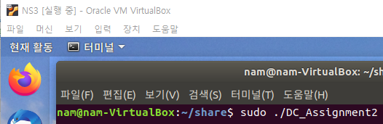
Program Run
Run the program simultaneously in each VM
After 5s, the programs run

Slide 14
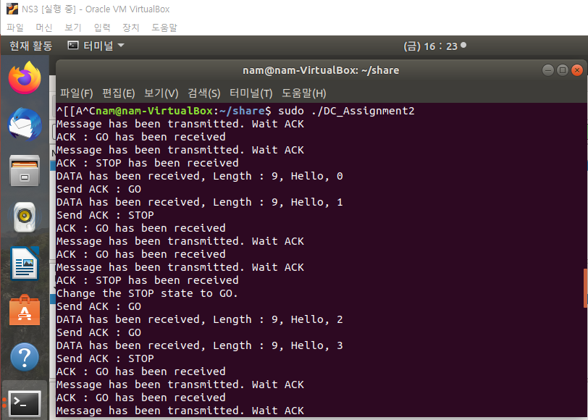
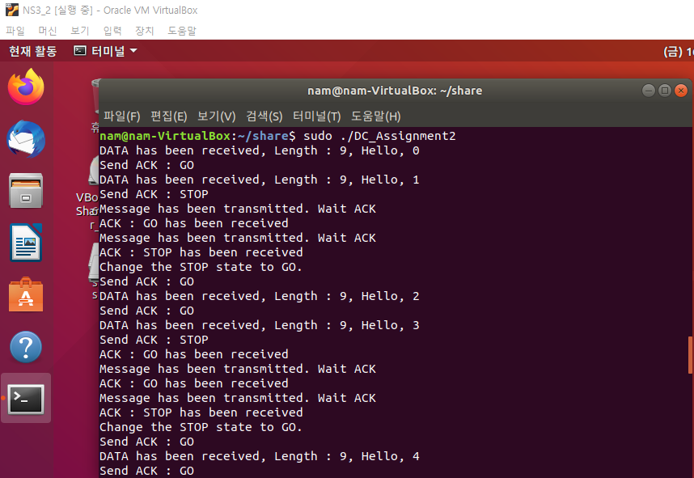
Program Run

Slide 15
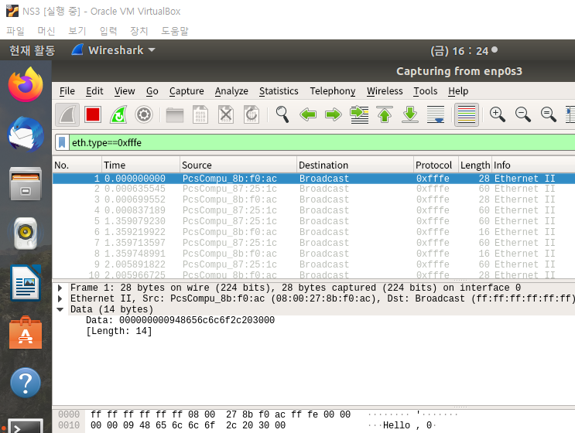
Program Run
Type : 0x00 (Data)
Data Length : 0x00000009 (9)
Data : “Hello, 0\0”

Slide 16
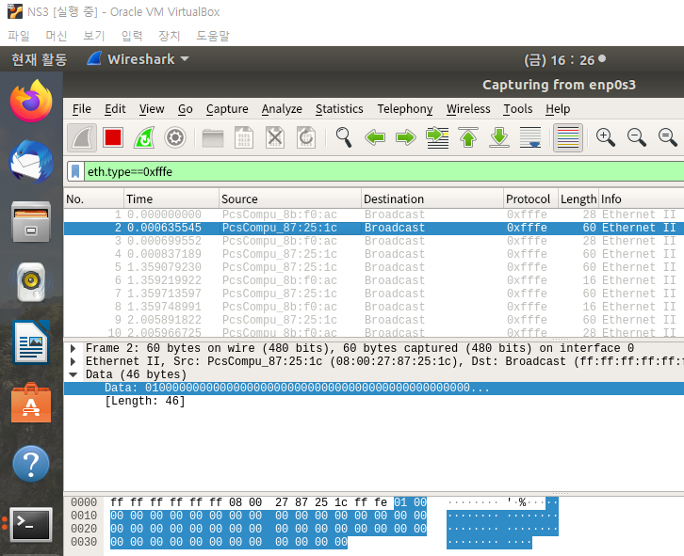
Program Run
Type : 0x01 (ACK)
ACK Type : 0x00 (Go)
Ignore following bytes
“padding to make 64-bytes including CRC”

Slide 17
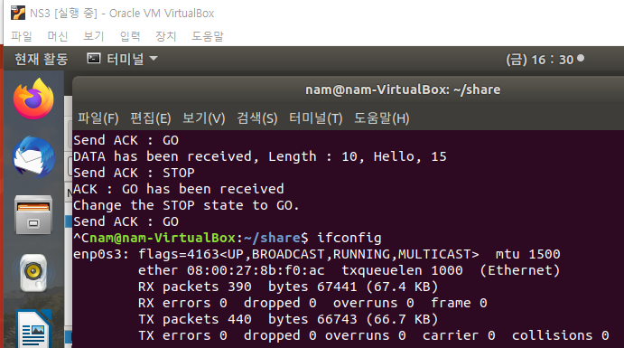
Check the MAC address of an interface
VM1

Slide 18
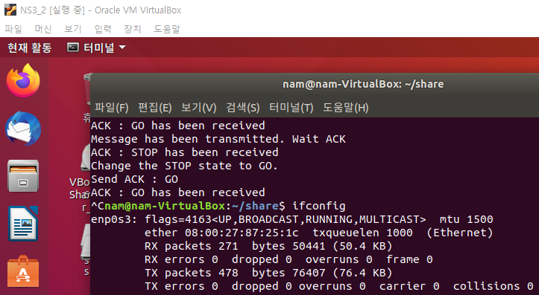
Check the MAC address of an interface
VM2

Slide 19
From VM1 From VM2
From VM1 From VM2
From VM2
...

Slide 20
Submission
Code
Report with Wireshark Screenshots
Does the implemented code show the intended exchange flow?
Compress above files into .zip file
Due date : 12/17 23:59
No late submission

